Slide 1
Relational Database Model
S511 Session 4, IU-SLIS

Slide 2
Outline
Relational database concepts
  Tables
  Integrity Rules
  Relationships
Relational Algebra
S511 Session 4, IU-SLIS

Slide 3
Relational Database
Before
  File system
    organized data
  Hierarchical and Network database
    data + metadata + data structure ⇒ database
    addressed limitations of file system
    tied to complex physical structure.
After
  Conceptual simplicity
    store a collection of related entities in a “relational” table
  Focus on logical representation (human view of data)
    how data are physically stored is no longer an issue
  Database ⬄ RDBMS ⬄ application
    conducive to more effective design strategies
S511 Session 4, IU-SLIS
Notes:
manual vs. automatic transmission (physical vs. logical view of data)

Slide 4
Logical View of Data
Entity
  a person, place, event, or thing about which data is collected.
    e.g. a student
Entity Set
  a collection of entities that share common characteristics
  named to reflect its content
    e.g. STUDENT
Attributes
  characteristics of the entity.
    e.g. student number, name, birthdate
  named to reflect its content
    e.g. STU_NUM, STU_NAME, STU_DOB
Tables
  contains a group of related entities or entity set
  2-dimensional structure composed of rows and columns
  also called relations
S511 Session 4, IU-SLIS

Slide 5
Table Characteristics
2-dimensional structure with rows & columns
  Rows (tuples)
    represent single entity occurrence
  Columns
    represent attributes
    have a specific range of values (attribute domain)
    each column has a distinct name
    all values in a column must conform to the same data format
  Row/column intersection represents a single data value
  Rows and columns orders are inconsequential
Each table must have a primary key.
  Primary key is an attribute (or a combination of attributes) that uniquely identify each row
Relational database vs. File system terminology
  Rows == Records, Columns == Fields, Tables == Files
S511 Session 4, IU-SLIS

Slide 6
Table Characteristics
Table and Column names
  Max. 8 & 10 characters in older DBMS
  Cannot use special charcters (e.g. */.)
  Use descriptive names (e.g. STUDENT, STU_DOB)
Column characteristics
  Data type
    number, character, date, logical (Boolean)
  Format
    999.99, Xxxxxx, mm-dd-yy, Yes/No
  Range
    0-4, 35-65, {A,B,C,D}
S511 Session 4, IU-SLIS

Slide 7
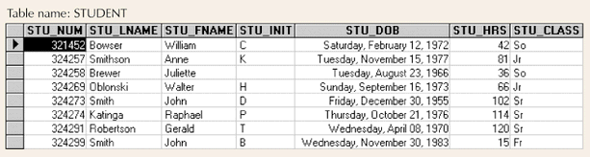
Example: Table
Database Systems: Design, Implementation, & Management: Rob & Coronel
8 rows & 7 columns
Row = single entity occurrence
  row 1 describes a student named William Bowser
Column = an attribute
  has specific characteristics (data type, format, value range)
    STU_CLASS: char(2), {Fr,Jr,So,Sr}
  all values adhere to the attribute characteristics
Each row/column intersection contains a single data value
Primary key = STU_NUM
S511 Session 4, IU-SLIS

Slide 8
Keys in a Table
Consists of one or more attributes that determine other attributes
  given the value of a key, you can look up (determine) the value of other attributes
  Composite key
    composed of more than one attribute
  Key attribute
    any attribute that is part of a key
Superkey
  any key that uniquely identifies each row
Candidate key
  superkey without redundancies
Primary Key
  a candidate key selected as the unique identifier
Foreign Key
  an attribute whose values match primary key values in the related table
  joins tables to derive information
Secondary Key
  facilitates querying of the database
  restrictive secondary key → narrow search result
    e.g. STU_LNAME vs. STU_DOB
S511 Session 4, IU-SLIS

Slide 9
Keys in a Table
Superkey
  attribute(s) that uniquely identifies each row
    STU_ID; STU_SSN; STU_ID + any; STU_SSN + any; STU_DOB + STU_LNAME + STU_FNAME?
Candidate Key
  minimal superkey
    STU_ID; STU_SSN; STU_DOB + STU_LNAME + STU_FNAME?
Primary Key
  candidate key selected as the unique identifier
    STU_ID
Foreign Key
  primary key from another table
    DEPT_CODE
Secondary Key
  attribute(s) used for data retrieval
    STU_LNAME + STU_DOB
DEPT_CODE | DEPT_NAME
243 | Astronomy
245 | Computer Science
423 | Sociology
STU_ID | STU_SSN | STU_DOB | STU_LNAME | STU_FNAME | DEPT_CODE
12345 | 111-11-1111 | 12/12/1985 | Doe | John | 245
12346 | 222-22-2222 | 10/10/1985 | Dew | John | 243
12348 | 123-45-6789 | 11/11/1982 | Dew | Jane | 423
S511 Session 4, IU-SLIS

Slide 10
Integrity Rules
Entity Integrity
  Each entity has unique key
    primary key values must be unique and not empty
  Ensures uniqueness of entities
    given a primary key value, the entity can be identified
    e.g., no students can have duplicate or null STU_ID
Referential Integrity
  Foreign key value is null or matches primary key values in related table
    i.e., foreign key cannot contain values that does not exist in the related table.
  Prevents invalid data entry
    e.g., James Dew may not belong to a department (Continuing Ed), but cannot be assigned to a non-existing department.
Most RDBMS enforce integrity rules automatically.
STU_ID | STU_LNAME | STU_FNAME | DEPT_CODE
12345 | Doe | John | 245
12346 | Dew | John | 243
22134 | Dew | James
DEPT_CODE | DEPT_NAME
243 | Astronomy
244 | Computer Science
245 | Sociology
S511 Session 4, IU-SLIS

Slide 11
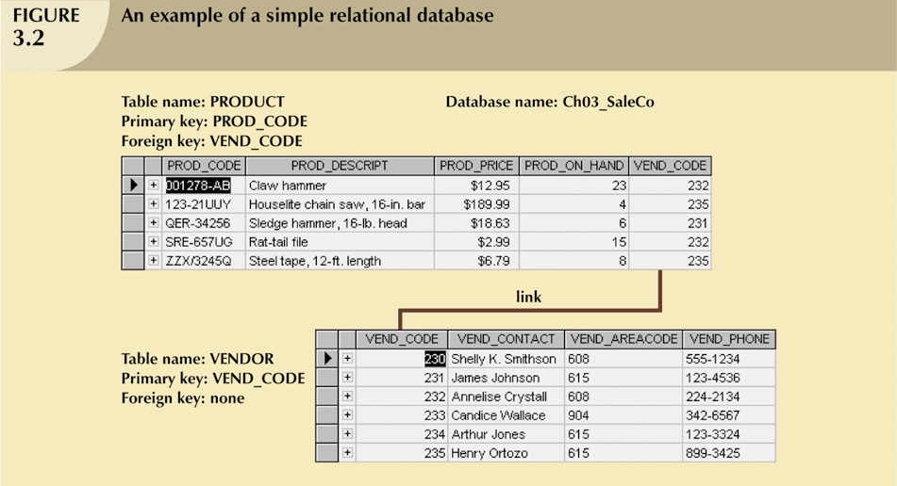
Example: Simple RDB
Database Systems: Design, Implementation, & Management: Rob & Coronel
S511 Session 4, IU-SLIS

Slide 12
Relationships in RDB
Representation of relationships among entities
  By shared attributes between tables (RDB model)
    primary key ⬄ foreign key
  E-R model provides a simplified picture
One-to-One (1:1)
  Could be due to improper data modeling
    e.g. PILOT (id, name, dob) to EMPLOYEE (id, name, dob)
  Commonly used to represent entity with uncommon attributes
    e.g. PILOT (id, license) to EMPLOYEE (id, name, dob, title)
One-to-Many (1:M)
  Most common relationship in RDB
  Primary key of the One should be the foreign key in the Many
Many-to-Many (M:N)
  Should not be accommodated in RDB directly
  Implement by breaking it into a set of 1:M relationships
    create a composite/bridge entity
S511 Session 4, IU-SLIS

Slide 13
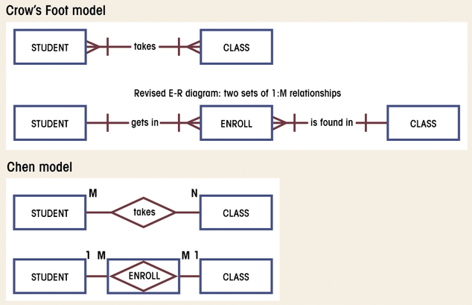
M:N to 1:M Conversion
Database Systems: Design, Implementation, & Management: Rob & Coronel
S511 Session 4, IU-SLIS

Slide 14
M:N to 1:M Conversion
STU_ID | STU_NAME | CLS_ID
1234 | John Doe | 10012
1234 | John Doe | 10014
2341 | Jane Doe | 10013
2341 | Jane Doe | 10014
2341 | Jane Doe | 10023
CLS_ID | STU_ID | CRS_NAME | CLS_SEC
10012 | 1234 | S511 | 1
10013 | 2341 | S511 | 2
10014 | 1234 | S517 | 1
10014 | 2341 | S517 | 1
10023 | 2341 | S534 | 1
STU_ID | STU_NAME
1234 | John Doe
2341 | Jane Doe
CLS_ID | STU_ID | ENR_GRD
10012 | 1234 | B
10013 | 2341 | A
10014 | 1234 | C
10014 | 2341 | A
10023 | 2341 | A
CLS_ID | CRS_NAME | CLS_SEC
10012 | S511 | 1
10013 | S511 | 2
10014 | S517 | 1
10023 | S534 | 1
Composite Table:
must contain at least the primary keys of original tables
contains multiple occurrences of the foreign key values
additional attributes may be assigned as needed
S511 Session 4, IU-SLIS

Slide 15
Data Integrity
Redundancy
  Uncontrolled Redundancy
    unnecessary duplication of data
      e.g. repeated attribute values in a table
      derived attributes (can be derived from existing attributes)
    proper use of foreign keys can reduce redundancy
      e.g. M:N to 1:M conversion
  Controlled Redundancy
    shared attributes in multiple tables
      makes RDB work (e.g. foreign key)
    designed to ensure transaction speed, information requirements
      e.g. account balance = account receivable - payments
      e.g. INV_PRICE records historical product price
PRD_ID | PRD_NAME | PRD_PRICE
1234 | Chainsaw | $100
2341 | Hammer | $10
INV_ID | PRD_ID | INV_PRICE
121 | 1234 | $80
122 | 2341 | $5
S511 Session 4, IU-SLIS

Slide 16
Data Integrity
Nulls
  No data entry
    a “not applicable” condition
      non-existing data
      e.g., middle initial, fax number
    an unknown attribute value
      non-obtainable data
      e.g., birthdate of John Doe
    a known, but missing, attribute value
      uncollected data
      e.g., date of hospitalization, cause of death
  Can create problems
    when functions such as COUNT, AVERAGE, and SUM are used
  Not permitted in primary key
    should be avoided in other attributes
S511 Session 4, IU-SLIS

Slide 17
Indexes
Composed of an index key and a set of pointers
  Points to data location (e.g. table rows)
  Makes retrieval of data faster
  each index is associated with only one table
ACTOR_NAME | ACTOR_ID
James Dean | 12
Henry Fonda | 23
Robert DeNiro | 34
 | MOVIE_ID | MOVIE_NAME | ACTOR_ID
1 | 231 | Rebel without Cause | 12
2 | 352 | Twelve Angry Men | 23
3 | 455 | Godfather 2 | 34
4 | 460 | Godfather II | 34
5 | 625 | On Golden Pond | 23
index key (ACTOR_ID) | pointers
12 | 1
23 | 2, 5
34 | 3, 4
S511 Session 4, IU-SLIS

Slide 18
Data Dictionary & Schema
Data Dictionary
  Detailed description of a data model
    for each table in a database
      list all the attributes & their characteristics
        e.g. name, data type, format, range
      identify primary and foreign keys
  Human view of entities, attributes, and relationships
    Blueprint & documentation of a database
      design & communication tool
Relational Schema
  Specification of the overall structure/organization of a database
    e.g. visualization of a structure
  Shows all the entities and relationships among them
    tables w/ attributes
    relationships (linked attributes)
      primary key ⬄ foreign key
    relationship type
      1:M, M:N, 1:1
S511 Session 4, IU-SLIS

Slide 19
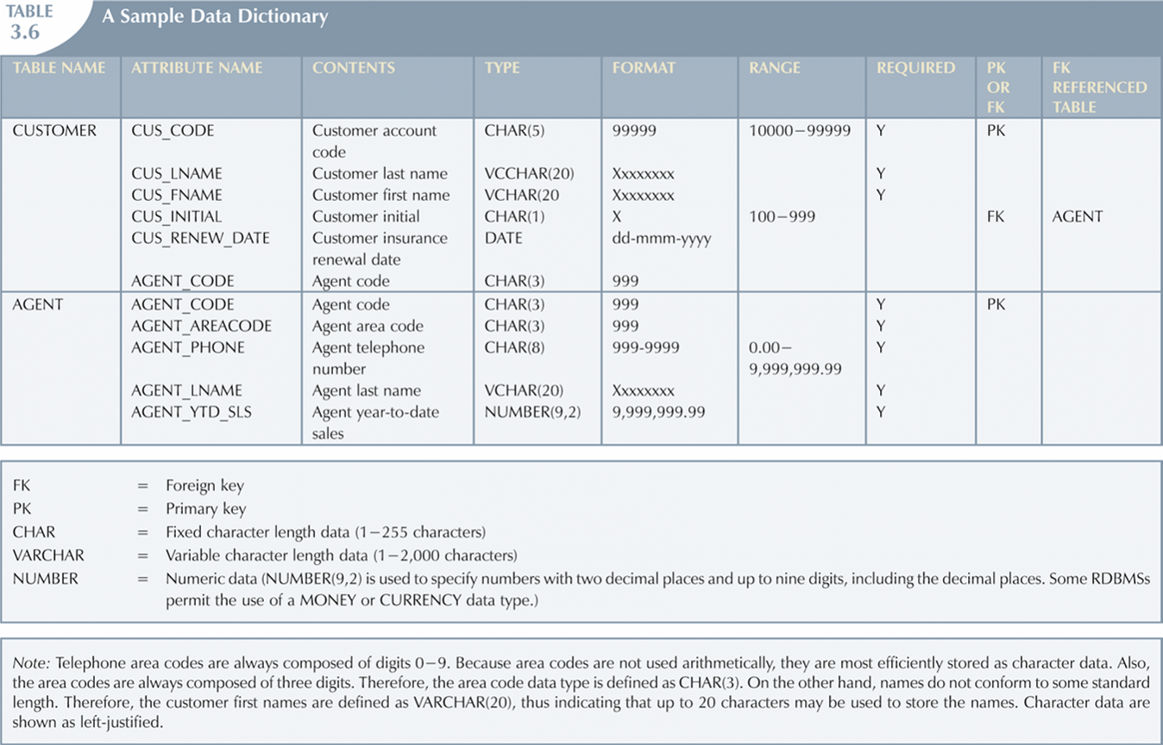
Data Dictionary
Lists attribute names and characteristics for each table in the database
  record of design decisions and blueprint for implementation
Database Systems: Design, Implementation, & Management: Rob & Coronel
S511 Session 4, IU-SLIS

Slide 20
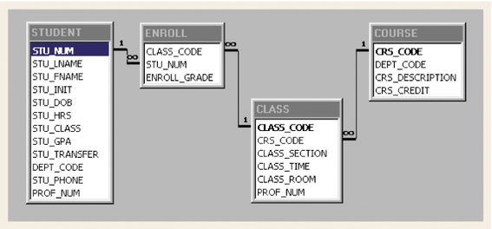
Relational Schema
A diagram of linked tables w/ attributes
Database Systems: Design, Implementation, & Management: Rob & Coronel
S511 Session 4, IU-SLIS

Slide 21
Relational Algebra
Method of manipulating table contents
  uses relational operators
Key relational operators
  SELECT
  PROJECT
  JOIN
Other relational operators
  INTERSECT
  UNION
  DIFFERENCE
  PRODUCT
  DIVIDE
S511 Session 4, IU-SLIS

Slide 22
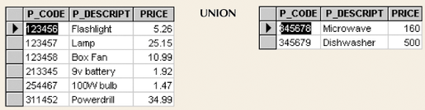
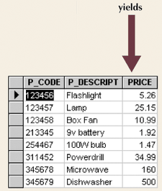
UNION: T1 ∪ T2
combines all rows from two tables
  duplicates rows are compress into a single row
  tables must be union-compatible
    union-compatible = tables have identical attributes
Database Systems: Design, Implementation, & Management: Rob & Coronel
S511 Session 4, IU-SLIS

Slide 23
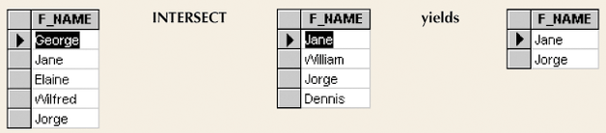
INTERSECT: T1 ∩ T2
yields rows that appear in both tables
  tables must be union-compatible
    e.g. attribute F_NAMEs must be of all same type
Database Systems: Design, Implementation, & Management: Rob & Coronel
S511 Session 4, IU-SLIS

Slide 24
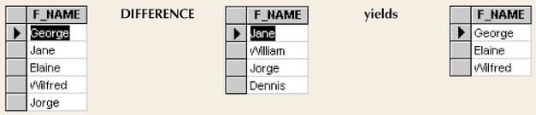
DIFFERENCE: T1 – T2
yields rows not found in the other table
  tables must be union-compatible
Database Systems: Design, Implementation, & Management: Rob & Coronel
S511 Session 4, IU-SLIS

Slide 25
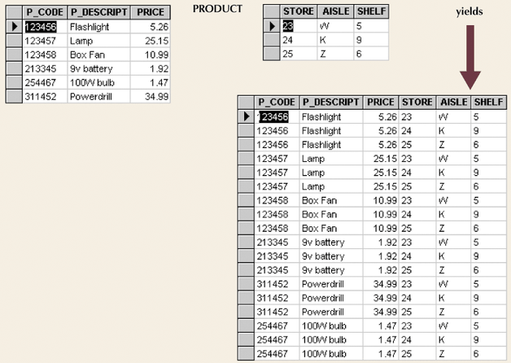
PRODUCT: T1 X T2
yields all possible pairs of rows from two tables
  Cartesian product: produces m*n rows
Database Systems: Design, Implementation, & Management: Rob & Coronel
S511 Session 4, IU-SLIS

Slide 26
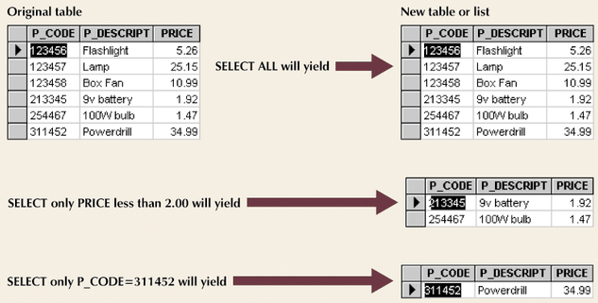
SELECT: σ _{a1<comparison>v1(T1)}
yields a row subset based on specified criterion
  operates on one table to produce a horizontal subset
Database Systems: Design, Implementation, & Management: Rob & Coronel
S511 Session 4, IU-SLIS
Notes:
sigma

Slide 27
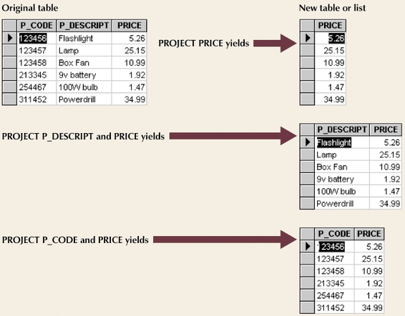
PROJECT: π _{a1,a2(T1)}
yields all values for selected columns
  operates on one table to produce a vertical subset
Database Systems: Design, Implementation, & Management: Rob & Coronel
S511 Session 4, IU-SLIS
Notes:
pi

Slide 28
JOIN: T1 |X|_{<join condition>} T2
combines “related” rows from multiple tables
  Product operation restricted to rows that satisfy join condition
  Join = Product + Select
Join types
  Theta Join
    T1 |X|_{<a1θ b1>} T2
  EquiJoin
    T1 |X|_{<a1= b1>} T2
  Natural Join
    T1 |X| T2
    EquiJoin + Project
  Outer Join
    left outer join: T1 ]X| T2
    right outer join: T1 |X[ T2
S511 Session 4, IU-SLIS
Notes:
pi

Slide 29
Theta JOIN: T1 |X|_{<a1θb1>} T2
Product + Selection_{<a1θ b1>}
EMP_NAME | EMP_AGE
Einstein | 67
Newton | 74
RET_AGE | RET_TYPE
60 | Early
70 | Full
75 | Extended
|X|_{<EMP_AGE >= RET_AGE>}
EMP_NAME | EMP_AGE | RET_AGE | RET_TYPE
Einstein | 67 | 60 | Early
Newton | 74 | 60 | Early
Newton | 74 | 70 | Full
S511 Session 4, IU-SLIS
Notes:
pi

Slide 30
EquiJOIN: T1 |X|_{<a1=b1>} T2
Product + Selection_{<a1= b1>}
PAY_LVL | PAY_AMT
12 | $100,000
15 | $150,000
21 | $200,000
EMP_SSN | EMP_NAME | EMP_LVL
123-45-6789 | Einstein | 21
987-65-4321 | Newton | 12D
|X|_{<EMP_LVL=PAY_LVL>}
EMP_SSN | EMP_NAME | EMP_LVL | PAY_LVL | PAY_AMT
123-45-6789 | Einstein | 21 | 21 | $200,000
PAY_LVL | PAY_AMT
12 | $100,000
15 | $150,000
21 | $200,000
EMP_SSN | EMP_NAME | PAY_LVL
123-45-6789 | Einstein | 21
987-65-4321 | Newton | 12D
|X|_{<PAY_LVL=21>}
EMP_SSN | EMP_NAME | PAY_LVL | PAY_LVL | PAY_AMT
123-45-6789 | Einstein | 21 | 21 | $200,000
S511 Session 4, IU-SLIS
Notes:
pi

Slide 31
Natural Join: T1 |X| T2
Product + Select (T1.a1 = T2.a1) + Project
  Equi-join by common attribute with duplicate column removal
EMP_SSN | EMP_NAME | PAY_LVL
123-45-6789 | Einstein | 21
987-65-4321 | Newton | 12
|X|
PAY_LVL | PAY_AMT
12 | $100,000
15 | $150,000
21 | $200,000
EMP_SSN | EMP_NAME | PAY_LVL | PAY_AMT
123-45-6789 | Einstein | 21 | $200,000
987-65-4321 | Newton | 12 | $100,000
S511 Session 4, IU-SLIS
Notes:
pi

Slide 32
Left Outer JOIN: T1 ]X| T2
Keep all rows from the left table with added columns from the right table
  good tool for finding referential integrity problems
EMP_SSN | EMP_NAME | PAY_LVL
123-45-6789 | Einstein | 12
987-65-4321 | Newton | 21D
PAY_LVL | PAY_AMT
12 | $100,000
15 | $150,000
21 | $200,000
]X|
EMP_SSN | EMP_NAME | PAY_LVL | PAY_AMT
123-45-6789 | Einstein | 12 | $100,000
987-65-4321 | Newton | 21D | ?
S511 Session 4, IU-SLIS
Notes:
pi

Slide 33
Right Outer JOIN: T1 |X[ T2
Keep all rows from the right table with added columns from the left table
EMP_SSN | EMP_NAME | PAY_LVL
123-45-6789 | Einstein | 12
987-65-4321 | Newton | 21D
PAY_LVL | PAY_AMT
12 | $100,000
15 | $150,000
21 | $200,000
|X[
EMP_SSN | EMP_NAME | PAY_LVL | PAY_AMT
123-45-6789 | Einstein | 12 | $100,000
 |  | 15 | $150,000
 |  | 21 | $200,000
S511 Session 4, IU-SLIS
Notes:
pi

Slide 34
DIVIDE: T1 % T2
“Divides” T1 into a row subset by shared attribute(s)
  result is a table with unshared attributes from T1
  Select rows from T1, whose shared attribute values match all of T2 values
  Project unshared attributes
JUDGE
1
2
3
GRADE
A
JUDGE | GRADE
1 | A
2 | A
3 | A
1 | B
2 | B
3 | A
%
JUDGE
1
2
GRADE
A
B
%
Database Systems: Design, Implementation, & Management: Rob & Coronel
S511 Session 4, IU-SLIS
Notes:
pi

Slide 35
Relational Algebra: Overview
union
intersect
difference
select
project
a
1
a
2
b
1
b
2
natural join
left outer join
right outer join
product
divide
S511 Session 4, IU-SLIS

Slide 36
Lab: Group Project (ongoing)
Form a Project Group.
Identify a potential project.
Discuss the database plan and consider its merit and feasibility.
Study the client organization and the end-users
  Information Flow
  Client objectives
  User requirements (e.g. database tasks, queries, interface)
Define a database plan
  Enumerate the tasks it will perform and questions it will answer
Construct the conceptual model of the database
  Identify, analyze, and refine the business rule
  Identify the main entities
  Define the relationships among entities
  Construct a preliminary ERD
  Define attributes, primary keys, and foreign keys for each entity
S511 Session 4, IU-SLIS

Slide 37
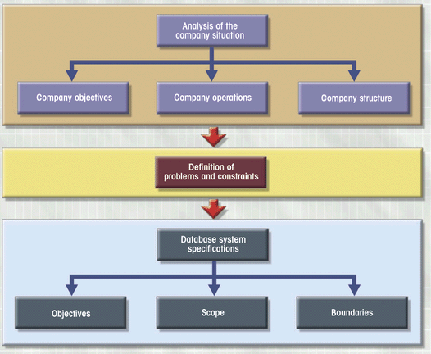
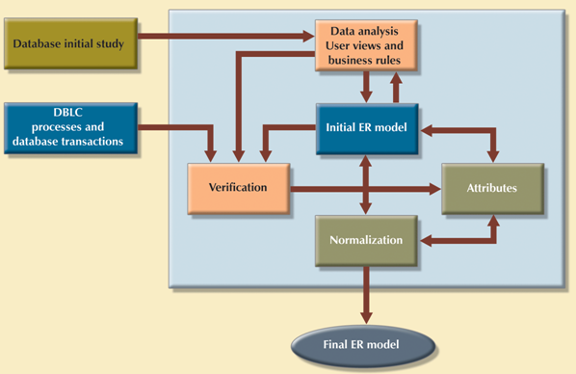
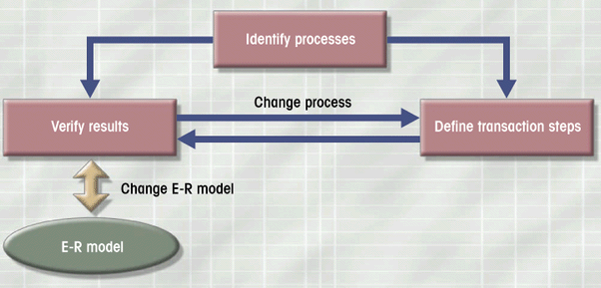
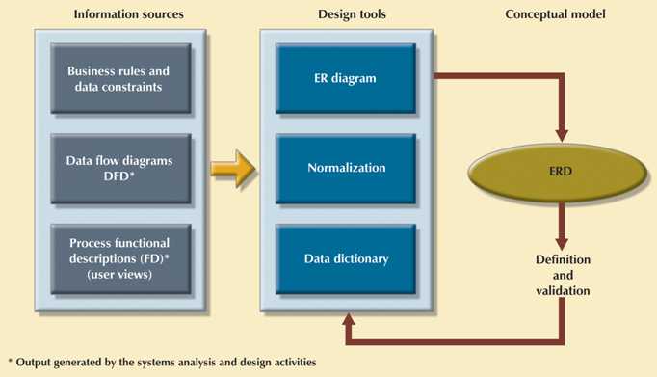
Database Design: At a Glance
Planning
&
Analysis
Maintenance
Conceptual Design
Implementation
Database Systems: Design, Implementation, & Management: Rob & Coronel
S511 Session 4, IU-SLIS

